Slide 1

Twiplomacy
a.k.a.: Twitter Diplomacy
#DigitalDiplomacy
by Levente Lukács F3HTOY

Slide 2
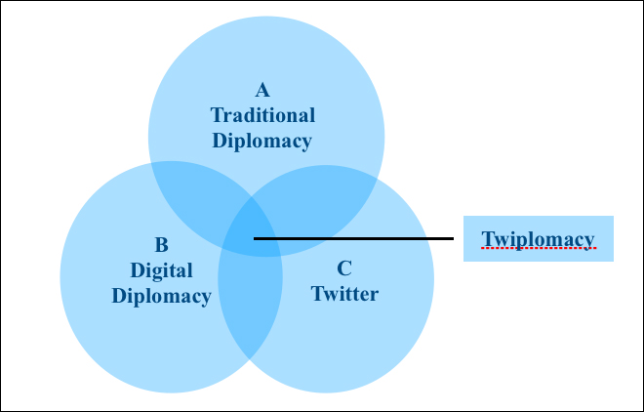
What is Twiplomacy?
Diplomacy conducted through the usage of Twitter (now called X)
Sharing opinions, initiating discussions, shaping public opinion
Casual
Easily accessible
Open
Fast
280 character-limit per post
Source: Observer Research Foundation (ORF)

Slide 3
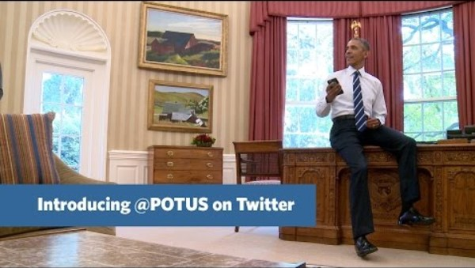
Early usage & numbers
1st leader on Twitter:
Barack Obama in 2007
By 2013: 78% of the 193 United Nations member states were on Twitter
➡ by 2018, it is 97%
By now, Obama has
131.8M followers
550M users
58% of users < 35 years of age
Average time per day is
~ 35 minutes
~ 500M posts per day
Source: YouTube

Slide 4
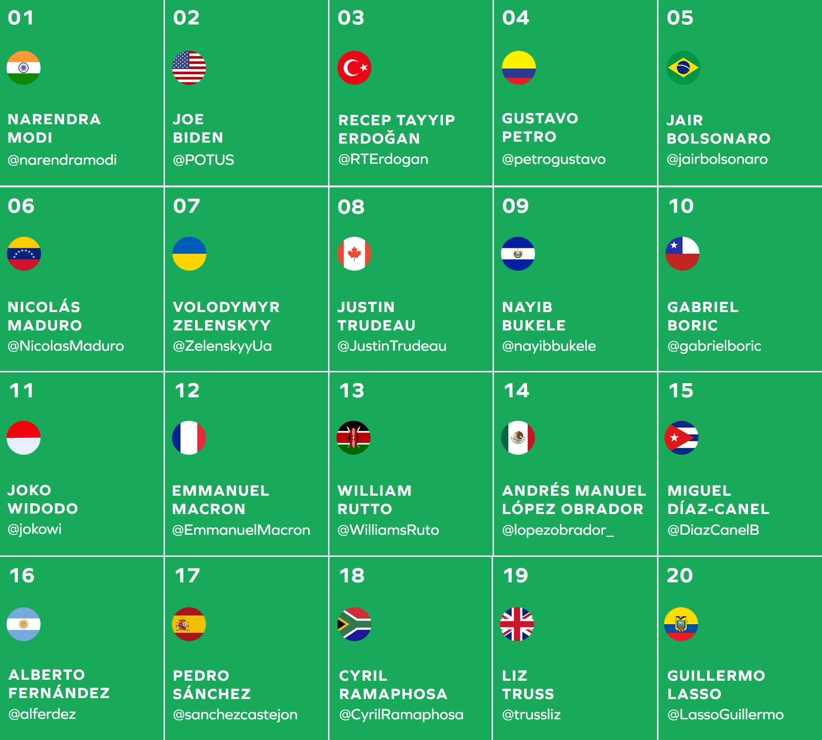
Notable Users & Their Influences
@elonmusk – 181.2M
@BarackObama – 131.8M
@narendramodi – 97.3M
@realDonaldTrump – 87.3M
@POTUS – 34.8M
@SushmaSwaraj – 12.5M
Source: Twiplomacy 2022 World Leader Power Ranking

Slide 5

Advantages & Risks
Accessible
Open
Fast
Wide-spread
Uncensored
Crisis management
Direct & personal
Short character count
Prone to misunderstandings
Prone to conflicts
Undermines official diplomacy
Question of security
Question of legitimacy

Slide 6

What might the future behold?
Twiplomacy is here to stay – what should change?
Increased supervision of posts
Consulting experts more often before posting
Following guidelines more clearly
Social media training for officials & leaders
Fact checking & contextual backgrounds

Slide 7

Thank you for your attention!
Bibliography
Chhabra, R. (2023, May 11). Twitter Diplomacy: A Brief Analysis. Retrieved from Observer Research Foundation: https://www.orfonline.org/research/twitter-diplomacy-a-brief-analysis-60462
Conger, K. (2023, August 24). Trump Returns to the Service Formerly Known as Twitter. Retrieved from The New York Times: https://www.nytimes.com/2023/08/24/technology/donald-trump-twitter-x-return.html
Duarte, F. (2023, November 20). X (Formerly Twitter) User Age, Gender, & Demographic Stats (2024). Retrieved from Exploding Topics: https://explodingtopics.com/blog/x-user-stats
Top 10 most followed accounts on Twitter / X in the world. (2024, March 13). Retrieved from Forbes India: https://www.forbesindia.com/article/explainers/most-followed-accounts-twitter-x/88311/1
Top 50 Power Ranking. (2022). Retrieved from bcw Twiplomacy: https://www.twiplomacy.com/top-50-world-leader-power-ranking
Wang, C. (2019, May 20). Twitter Diplomacy: Preventing Twitter Wars from Escalating into Real Wars. Retrieved from HARVARD Kennedy School Belfer Center for Science and International Affairs:
https://www.belfercenter.org/publication/twitter-diplomacy-preventing-twitter-wars-escalating-real-wars

