Slide 1
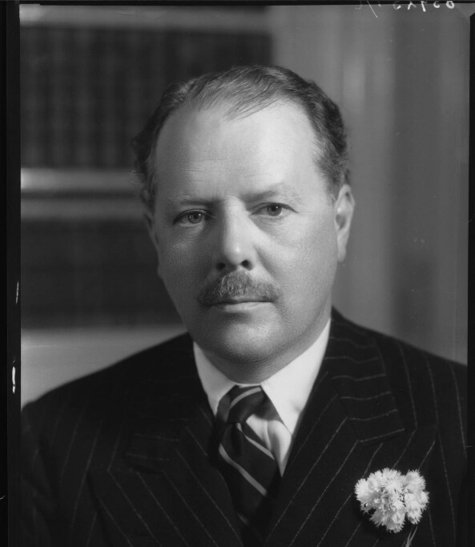
Harold Nicolson
& his role in public diplomacy
by Levente Lukács F3HTOY

Slide 2
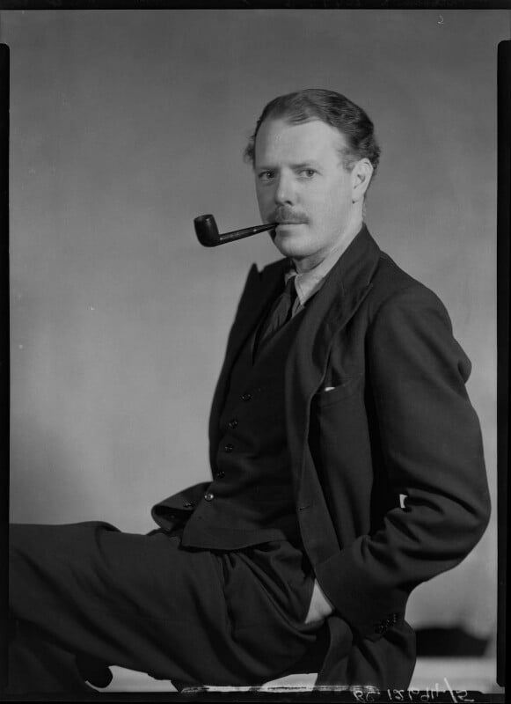
„One of the most articulate experts and best-informed writers on diplomacy”
(Lewis Namier)
Born in 1886
Part of a wealthy, minor patrician family
Family members in politics ➡ role models
Important life-long work in diplomacy
Important topics:
  Early career
  Foreign policy
  Concept of diplomacy
  Old & new diplomacy
  Political guidance
  The „ideal diplomatist”
  Diplomacy by conference

Slide 3
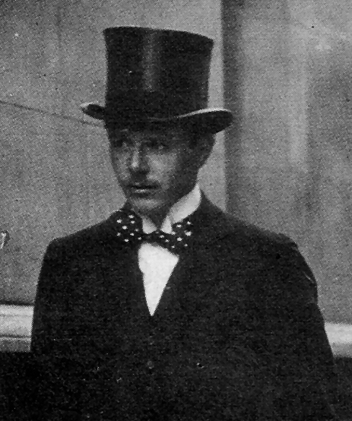
I. Early career
He was educated at Wellington & Balliol
He entered diplomatic service in 1909
  Madrid, Constantinople, Foreign Office, British delegation
Believes in the League of Nations – later on becomes skeptical
Advocates for US links
Experience in international politics in the post-war years
  1920s: counsellor at the Tehran legation
  1926: criticizing Britain’s Persian policy
  1927: demotion to the rank of secretary
1929: he becomes a journalist for the Beaverbrook press

Slide 4

II. Foreign Policy
2 important works:
  Diplomacy (1939)
  The Evolution of Diplomatic Method (1954)
Scepticism regarding international law’s efficiency
He wrote no foreign policy „can ever be reliable unless it be based upon national egoism”
„Good” & „bad” foreign policies
Balance of power as the best method of preserving international peace

Slide 5
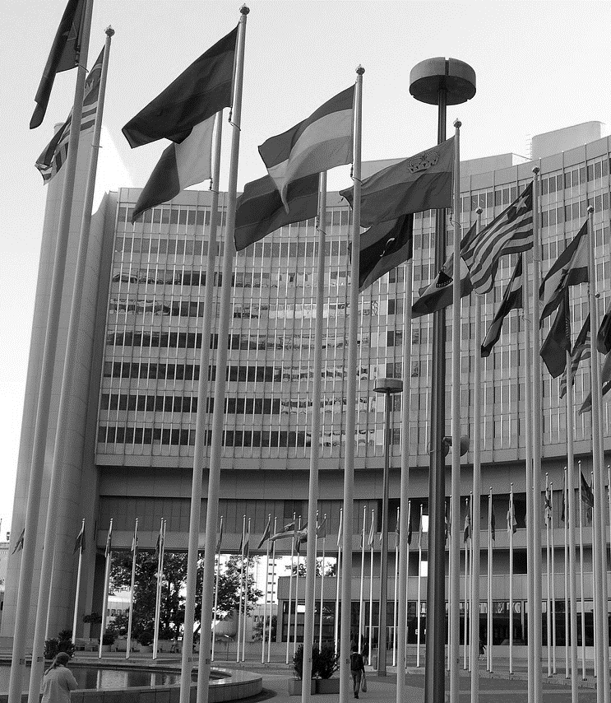
III. Concept of Diplomacy
He wanted to develop a new definition for diplomacy
  He writes several definitions ➡ they all have certain ideas in common
  According to his definitions:
    There is some existing alienation between different groups
    Diplomacy is necessary for relations between groups
    There must be an agreed framework / code of conduct
    Diplomacy is a system of negotiation

Slide 6

IV. Old & New Diplomacy
New diplomacy has a big effect on his career ➡ more complex than it seemed at first glance
2 main points in the writings of Nicolson when it comes to the transition from „old” to „new” diplomacy:
  The impact of modern policy-making on diplomacy
    Everyone is subject to a higher-ranked representative
    The importance of the public’s involvement
  Diplomacy by personal contact between political leaders
    Nicolson insisted that diplomacy should be practiced in writing, as to him, talks and conversation could lead to inaccuracies & misunderstandings

Slide 7

V. Political Guidance
According to Nicolson, professional diplomatists should have political guidance to succeed in diplomacy
Diplomacy =/= foreign policy
He suggested 4 principles as general foreign policy guidelines:
  „Foreign policy should always be straight-forward, open and precise.”
  „No Government should make promises which they cannot perform.”
  The government was required to „have a clear conception of
  [the country's] relative strength.”
  Foreign policy „should never be influenced by such emotions as prestige, party prejudice, sentiment of adventure".

Slide 8
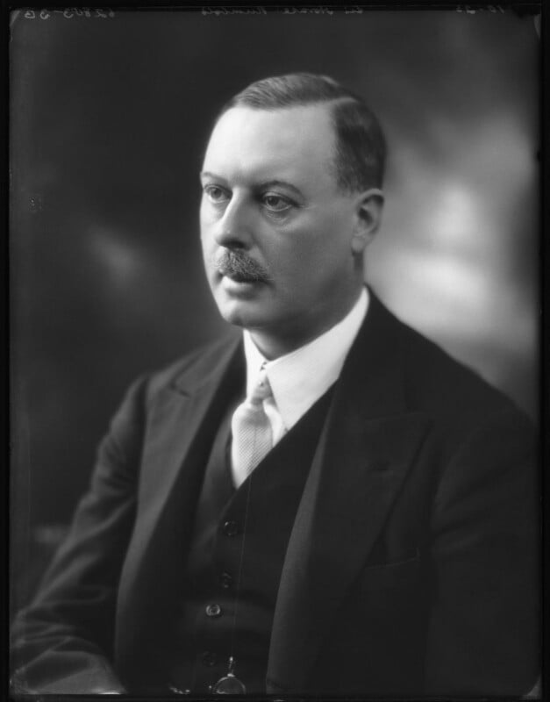
VI. The „ideal diplomatist”
Interwar years: diplomatic profession in disrepute ➡ Nicolson wanted to restore it
According to Nicolson, the qualities of a good diplomatist included
  truth, accuracy, calmness, patience, good temper, modesty, loyalty, intelligence, knowledge, discernment, prudence, hospitality, charm, industry, courage & tact
He described Sir Horace Rumbold as the ideal diplomatist
„The business of the diplomatist is to represent his own government in a foreign country"

Slide 9

VII. Diplomacy by Conference
1919: Paris Peace Conference – diplomacy by conference
Nicolson did NOT like it
He attended 3 major international conferences
  1919 Paris Peace Conference
  1923 Lausanne Conference
  1946 Paris Peace Conference
To Nicolson, it was „perhaps the most unfortunate diplomatic method ever conceived„ BUT
„There are occasions when international agreement can only be achieved by oral discussion between plenipotentiaries."

Slide 10
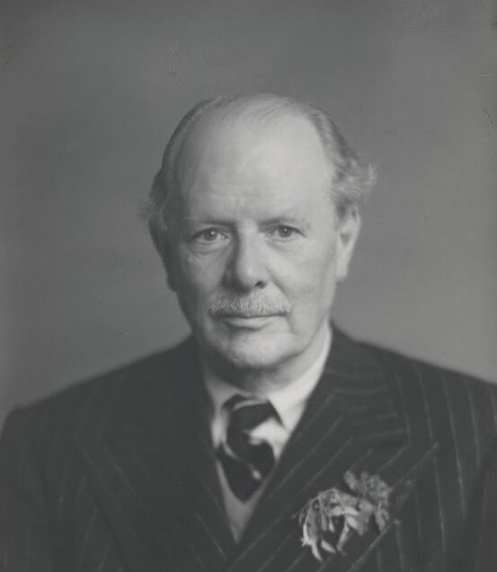
VIII. In Conclusion
A significant character in diplomacy with significant works & accessible writings
His criticisms and warnings were based on reasoned arguments
  Enlighted realism & humane scepticism
He had „a slightly quixotic professional career” & ultimately unfulfilled political ambitions
„A 19th century character living an 18th century life in the 20th century”

Slide 11

Thank you for your attention!
Bibliography:
Berridge, G. R., Keens-Soper, M., & Otte, T. G. (2001). Diplomatic Theory from Machiavelli to Kissinger. PALGRAVE.

